Slide 1
CSC 3342 Computer Graphics
Chapter 4
Geometric Objects & Transformations

Slide 2
Geometry

Slide 3
Objectives
Introduce the elements of geometry
Scalars
Vectors
Points
Develop mathematical operations among them in a coordinate-free manner
Define basic primitives
Line segments
Polygons

Slide 4
Basic Elements
Geometry is the study of the relationships among objects in an n-dimensional space
In computer graphics, we are interested in objects that exist in three dimensions
Want a minimum set of primitives from which we can build more sophisticated objects
We will need three basic elements
Scalars
Vectors
Points

Slide 5
Coordinate-Free Geometry
When we learned simple geometry, most of us started with a Cartesian approach
Points were at locations in space p=(x,y,z)
We derived results by algebraic manipulations involving these coordinates
This approach was nonphysical
Physically, points exist regardless of the location of an arbitrary coordinate system
Most geometric results are independent of the coordinate system
Example Euclidean geometry: two triangles are identical if two corresponding sides and the angle between them are identical

Slide 6
Scalars
Need three basic elements in geometry
Scalars, Vectors, Points
Scalars can be defined as members of sets which can be combined by two operations (addition and multiplication) obeying some fundamental axioms (associativity, commutivity, inverses)
Examples include the real and complex number systems under the ordinary rules with which we are familiar
Scalars alone have no geometric properties

Slide 7
Vectors
Physical definition: a vector is a quantity with two attributes
Direction
Magnitude
Examples include
Force
Velocity
Directed line segments
Most important example for graphics
Can map to other types
v

Slide 8
Vector Operations
Every vector has an inverse
Same magnitude but points in opposite direction
Every vector can be multiplied by a scalar
There is a zero vector
Zero magnitude, undefined orientation
The sum of any two vectors is a vector
Use head-to-tail axiom
v
w
v
-v
αv
u

Slide 9
Linear Vector Spaces
Mathematical system for manipulating vectors
Operations
Scalar-vector multiplication u=αv
Vector-vector addition: w=u+v
Expressions such as
v=u+2w-3r
Make sense in a vector space

Slide 10
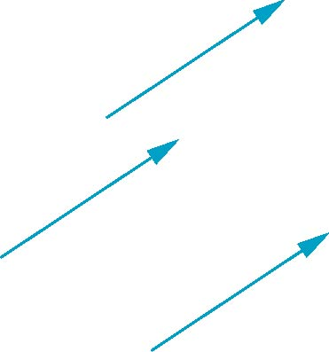
Vectors Lack Position
These vectors are identical
Same length and magnitude
Vectors spaces insufficient for geometry
Need points

Slide 11
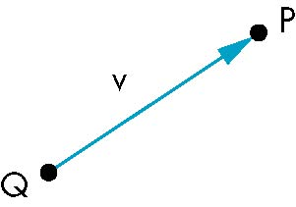
Points
Location in space
Operations allowed between points and vectors
Point-point subtraction yields a vector
Equivalent to point-vector addition
v=P-Q
P=v+Q

Slide 12
Affine Spaces
Point + a vector space
Operations
Vector-vector addition
Scalar-vector multiplication
Point-vector addition
Scalar-scalar operations
For any point define
1 • P = P
0 • P = 0 (zero vector)

Slide 13
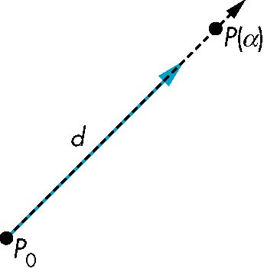
Lines
Consider all points of the form
P(α)=P₀ + α d
Set of all points that pass through P₀ in the direction of the vector d

Slide 14
Parametric Form
This form is known as the parametric form of the line
More robust and general than other forms
Extends to curves and surfaces
Two-dimensional forms
Explicit: y = mx +h
Implicit: ax + by +c =0
Parametric:
x(α) = αx₀ + (1-α)x₁
y(α) = αy₀ + (1-α)y₁

Slide 15
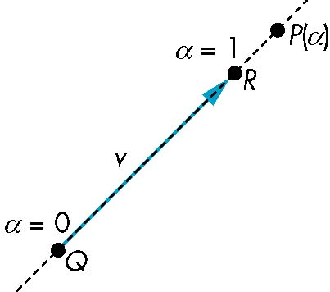
Rays and Line Segments
If α >= 0, then P(α) is the ray leaving P₀ in the direction d
If we use two points to define v, then
P( α) = Q + α (R-Q)=Q+αv
=αR + (1-α)Q
For 0<=α<=1 we get all the
points on the line segment
joining R and Q

Slide 16
Convexity
An object is convex iff for any two points in the object all points on the line segment between these points are also in the object
P
P
Q
Q
not convex
convex

Slide 17
Affine Sums
Consider the “sum”
P=α₁P₁+α₂P₂+…..+α_{n}P_{n}
Can show by induction that this sum makes sense iff
α₁+α₂+…..α_{n}=1
in which case we have the affine sum of the points P₁,P₂,…..P_{n}
If, in addition, α_{i}>=0, we have the convex hull of P₁,P₂,…..P_{n}

Slide 18
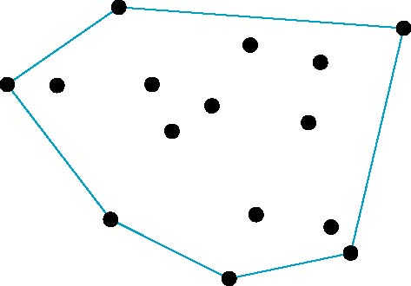
Convex Hull
Smallest convex object containing P₁,P₂,…..P_{n}
Formed by “shrink wrapping” points

Slide 19
Curves and Surfaces
Curves are one parameter entities of the form P(α) where the function is nonlinear
Surfaces are formed from two-parameter functions P(α, β)
Linear functions give planes and polygons
P(α)
P(α, β)

Slide 20
Planes
A plane can be defined by a point and two vectors or by three points
P
v
Q
R
u
R
P(α,β)=R+αu+βv
P(α,β)=R+α(Q-R)+β(P-Q)

Slide 21
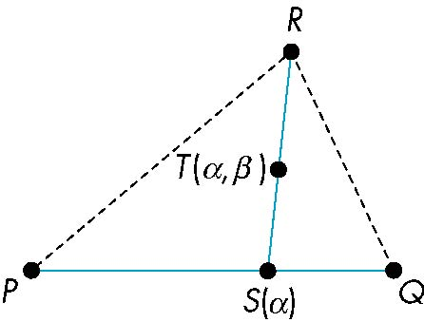
Triangles
convex sum of S(α) and R
convex sum of P and Q
for 0<=α,β<=1, we get all points in triangle

Slide 22
Barycentric Coordinates
Triangle is convex so any point inside can be represented as an affine sum
P(α_{1,} α_{2,} α₃)=α₁P+α₂Q+α₃R
where
α₁ +α₂ +α₃ = 1
α_{i}>=0
The representation is called the barycentric coordinate representation of P

Slide 23
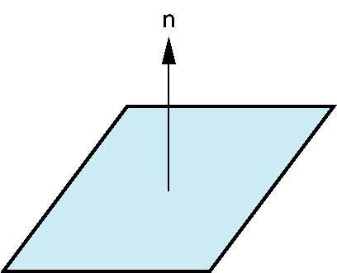
Normals
In three dimensional spaces, every plane has a vector n perpendicular or orthogonal to it called the normal vector
From the two-point vector form P(α,β)=P+αu+βv, we know we can use the cross product to find n = u × v and the equivalent form
(P(α, β)-P) ⋅ n=0
v
u
P

Slide 24
Representation

Slide 25
Objectives
Introduce concepts such as dimension and basis
Introduce coordinate systems for representing vectors spaces and frames for representing affine spaces
Discuss change of frames and bases

Slide 26
Linear Independence
A set of vectors v₁, v₂, …, v_{n} is linearly independent if
α₁v₁+α₂v₂+.. α_{n}v_{n}=0 iff α₁=α₂=…=0
If a set of vectors is linearly independent, we cannot represent one in terms of the others
If a set of vectors is linearly dependent, at least one can be written in terms of the others

Slide 27
Dimension
In a vector space, the maximum number of linearly independent vectors is fixed and is called the dimension of the space
In an n-dimensional space, any set of n linearly independent vectors form a basis for the space
Given a basis v₁, v₂,…., v_{n}, any vector v can be written as
v=α₁v₁+ α₂v₂ +….+α_{n}v_{n}
where the {α_{i}} are unique

Slide 28
Representation
Until now we have been able to work with geometric entities without using any frame of reference, such as a coordinate system
Need a frame of reference to relate points and objects to our physical world.
For example, where is a point? Can’t answer without a reference system
World coordinates
Camera coordinates

Slide 29
Coordinate Systems
Consider a basis v₁, v₂,…., v_{n}
A vector is written v=α₁v₁+ α₂v₂ +….+α_{n}v_{n}
The list of scalars {α₁, α₂, …. α_{n}}is the representation of v with respect to the given basis
We can write the representation as a row or column array of scalars
a=[α₁ α₂ …. α_{n}]^{T}=

Slide 30
Example
v=2v₁+3v₂-4v₃
a=[2 3 –4]^{T}
Note that this representation is with respect to a particular basis
For example, in WebGL we will start by representing vectors using the object basis but later the system needs a representation in terms of the camera or eye basis

Slide 31
Coordinate Systems
Which is correct?
Both are because vectors have no fixed location
v
v

Slide 32
Frames
A coordinate system is insufficient to represent points
If we work in an affine space we can add a single point, the origin, to the basis vectors to form a frame
v₂
v₁
P₀
v₃

Slide 33
Representation in a Frame
Frame determined by (P₀, v₁, v₂, v₃)
Within this frame, every vector can be written as
v=α₁v₁+ α₂v₂ +….+α_{n}v_{n}
Every point can be written as
P = P₀ + β₁v₁+ β₂v₂ +….+β_{n}v_{n}

Slide 34
Confusing Points and Vectors
Consider the point and the vector
P = P₀ + β₁v₁+ β₂v₂ +….+β_{n}v_{n}
v=α₁v₁+ α₂v₂ +….+α_{n}v_{n}
They appear to have the similar representations
p=[β₁ β₂ β₃] v=[α₁ α₂ α₃]
which confuses the point with the vector
A vector has no position
v
p
v
Vector can be placed anywhere
point: fixed

Slide 35
Homogeneous Coordinates

Slide 36
Objectives
Introduce homogeneous coordinates
Introduce change of representation for both vectors and points

Slide 37
A Single Representation
If we define 0•P = 0 and 1•P =P then we can write
v=α₁v₁+ α₂v₂ +α₃v₃ = [α₁ α₂ α₃ 0 ] [v₁ v₂ v₃ P₀] ^{T}
P = P₀ + β₁v₁+ β₂v₂ +β₃v₃= [β₁ β₂ β₃ 1 ] [v₁ v₂ v₃ P₀] ^{T}
Thus we obtain the four-dimensional homogeneous coordinate representation
v = [α₁ α₂ α₃ 0 ] ^{T}
p = [β₁ β₂ β₃ 1 ] ^{T}

Slide 38
Homogeneous Coordinates
Homogeneous coordinates are key to all computer graphics systems
All standard transformations (rotation, translation, scaling) can be implemented with matrix multiplications using 4 x 4 matrices
Hardware pipeline works with 4 dimensional representations
For orthographic viewing, we can maintain w=0 for vectors and w=1 for points
For perspective we need a perspective division

Slide 39
Change of Coordinate Systems
Consider two representations of a the same vector with respect to two different bases. The representations are
a=[α₁ α₂ α₃ ]
b=[β₁ β₂ β₃]
where
v=α₁v₁+ α₂v₂ +α₃v₃ = [α₁ α₂ α₃] [v₁ v₂ v₃] ^{T}
=β₁u₁+ β₂u₂ +β₃u₃ = [β₁ β₂ β₃] [u₁ u₂ u₃] ^{T}

Slide 40
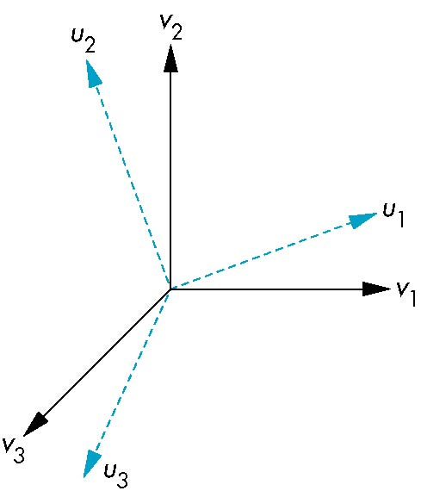
Representing second basis in terms of first
Each of the basis vectors, u1,u2, u3, are vectors that can be represented in terms of the first basis
v
u₁ = γ₁₁v₁+γ₁₂v₂+γ₁₃v₃
u₂ = γ₂₁v₁+γ₂₂v₂+γ₂₃v₃
u₃ = γ₃₁v₁+γ₃₂v₂+γ₃₃v₃

Slide 41
Matrix Form
The coefficients define a 3 x 3 matrix
and the bases can be related by
see text for numerical examples
M =
a=M^{T}b

Slide 42
Change of Frames
We can apply a similar process in homogeneous coordinates to the representations of both points and vectors
Any point or vector can be represented in either frame
We can represent Q₀, u₁, u₂, u₃ in terms of P₀, v₁, v₂, v₃
u₂
u₁
v₂
Consider two frames:
(P₀, v₁, v₂, v₃)
(Q₀, u₁, u₂, u₃)
Q₀
P₀
v₁
u₃
v₃

Slide 43
Representing One Frame in Terms of the Other
Extending what we did with change of bases
u₁ = γ₁₁v₁+γ₁₂v₂+γ₁₃v₃
u₂ = γ₂₁v₁+γ₂₂v₂+γ₂₃v₃
u₃ = γ₃₁v₁+γ₃₂v₂+γ₃₃v₃
Q₀ = γ₄₁v₁+γ₄₂v₂+γ₄₃v₃ +γ₄₄P₀
defining a 4 x 4 matrix
M =

Slide 44
Working with Representations
Within the two frames any point or vector has a representation of the same form
a=[α₁ α₂ α₃ α₄ ] in the first frame
b=[β₁ β₂ β₃ β₄ ] in the second frame
where α₄ = β₄ = 1 for points and α₄ = β₄ = 0 for vectors and
The matrix M is 4 x 4 and specifies an affine transformation in homogeneous coordinates
a=M^{T}b

Slide 45
Affine Transformations
Every linear transformation is equivalent to a change in frames
Every affine transformation preserves lines
However, an affine transformation has only 12 degrees of freedom because 4 of the elements in the matrix are fixed and are a subset of all possible 4 x 4 linear transformations

Slide 46
The World and Camera Frames
When we work with representations, we work with n-tuples or arrays of scalars
Changes in frame are then defined by 4 x 4 matrices
In OpenGL, the base frame that we start with is the world frame
Eventually we represent entities in the camera frame by changing the world representation using the model-view matrix
Initially these frames are the same (M=I)

Slide 47
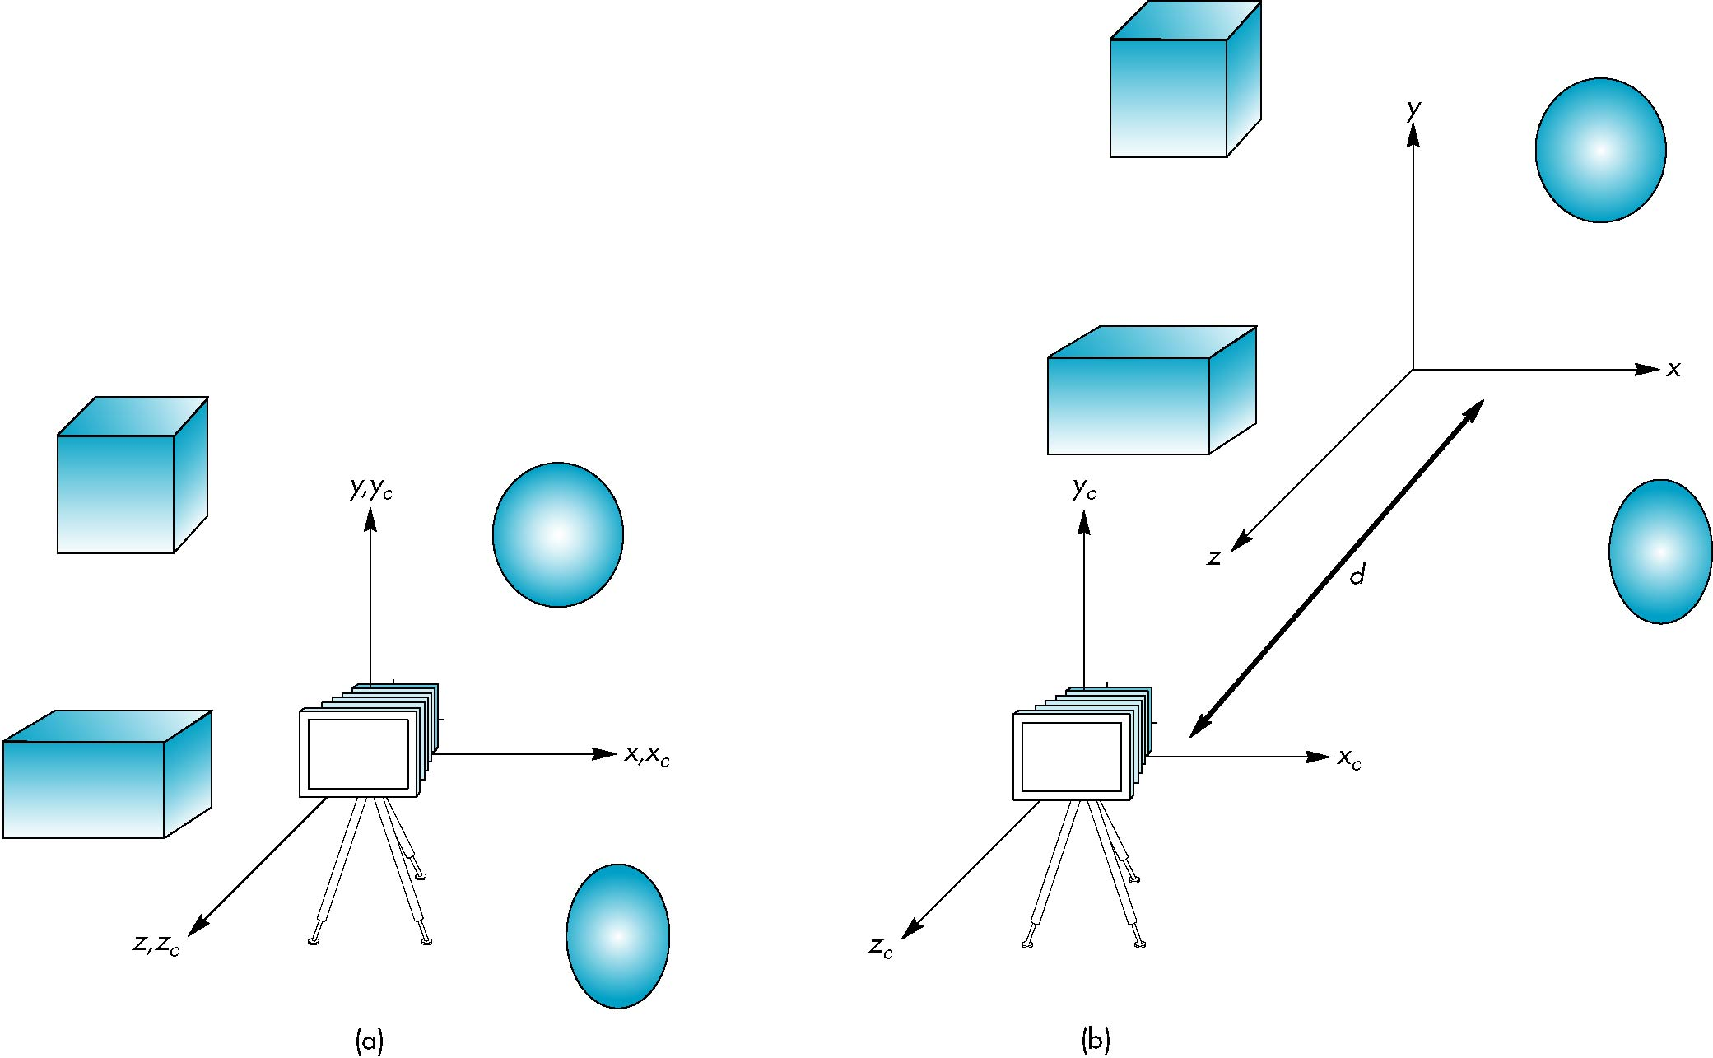
Moving the Camera
If objects are on both sides of z=0, we must move camera frame
M =

Slide 48
Transformations

Slide 49
Objectives
Introduce standard transformations
Rotation
Translation
Scaling
Shear
Derive homogeneous coordinate transformation matrices
Learn to build arbitrary transformation matrices from simple transformations

Slide 50
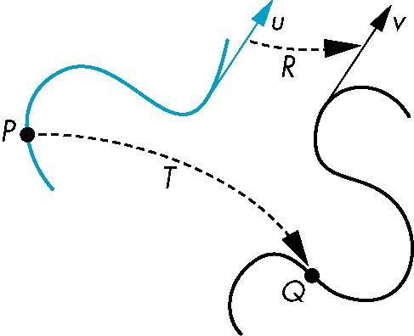
General Transformations
A transformation maps points to other points and/or vectors to other vectors
v=T(u)
Q=T(P)

Slide 51
Affine Transformations
Line preserving
Characteristic of many physically important transformations
Rigid body transformations: rotation, translation
Scaling, shear
Importance in graphics is that we need only transform endpoints of line segments and let implementation draw line segment between the transformed endpoints

Slide 52
Pipeline Implementation
T
(from application program)
frame
buffer
u
transformation
T(u)
rasterizer
v
T(v)
T(v)
T(v)
v
T(u)
u
T(u)
vertices
vertices
pixels

Slide 53
Notation
We will be working with both coordinate-free representations of transformations and representations within a particular frame
P,Q, R: points in an affine space
u, v, w: vectors in an affine space
α, β, γ: scalars
p, q, r: representations of points
-array of 4 scalars in homogeneous coordinates
u, v, w: representations of points
-array of 4 scalars in homogeneous coordinates

Slide 54
Translation
Move (translate, displace) a point to a new location
Displacement determined by a vector d
Three degrees of freedom
P’=P+d
P’
d
P

Slide 55
2D Transformations
x,y points to x’,y’ points
We’ll use to derive the 3D transformations

Slide 56




Affine operations
Translation
x’ = x + c
y’ = y + f
Scaling
x’ = ax
y’ = dy
Rotation (CCW about 0,0)
x’ = xcosq - ysinq
y’ = xsinq + ycosq
Skew (or Shear)
x’ = x + ay
y’ = y

Slide 57
Where does that rotation equation come from?
x’,y’
x,y
θ
Rotation (CCW about 0,0)
x’ = xcosθ - ysinθ
y’ = xsinθ + ycosθ

Slide 58
Where does that rotation equation come from?
x=hcosφ
y=hsinφ
x’=hcos(φ+θ)
y’=hsin(φ+θ)
x’=hcos(φ+θ)
=hcosφcosθ – hsinφsinθ
=xcosθ – ysinθ
y’=hsin(φ+θ)
=hcosφsinθ + hsinφcosθ
=xsinθ + ycosθ
x’,y’
h
x,y
θ
h
φ

Slide 59
Affine transformations
General formulation
x’ = ax + by + c
y’ = dx + ey + f

Slide 60
We want to express operations using matrices
Express points at [x y]^{T}
Operations as matrix multiplication
But, won’t do:
x’ = ax + by + c
y’ = dx + ey + f

Slide 61
Homogeneous coordinates in 2D
Express points at [x y 1]^{T}
3 element vector!
Why?

Slide 62
Identity Matrix

Slide 63
Translation matrix
We can express translation using this matrix:

Slide 64

A Simple Transformation Task
Rotate an image around it’s center by 30 degrees.
Transformation needed: point in Cartman image to destination
To figure out where things will go

Slide 65
What will it take in affine operations?
y
x
Can we just rotate?

Slide 66
Step 1: Translation to rotation point
y
y
x
x
Translate by (-w/2, -h/2)

Slide 67
After the translation
y
x

Slide 68
Rotation matrix
y
y
x
x
CCW rotation
about 0,0:
x’ = xcosq - ysinq
y’ = xsinq + ycosq

Slide 69
Rotate
y
x

Slide 70
Last task, translate center back to where it was before
y
y
x
x
Translate by (w/2, h/2)

Slide 71
All together, now!
Important, points before rotation to points after rotation!
Translation M₁ first:
Rotation:
Translation M₂ next:

Slide 72
Composing operations
Notice:

Slide 73
The whole thing:
M=M₂ R₃₀ M₁
Just multiply all of the transformations!
We can then implement this in a simple 3x3 matrix multiplied by a 3 element vector for any vertex!

Slide 74
Example
Assume 100 by 100 image.

Slide 75
Important
Any sequence of matrix operations can be composed into a single matrix
We’ll always use an extra dimension for all vertices (x,y,w)

Slide 76
Translation Using Representations
Using the homogeneous coordinate representation in some frame
p=[ x y z 1]^{T}
p’=[x’ y’ z’ 1]^{T}
d=[dx dy dz 0]^{T}
Hence p’ = p + d or
x’=x+d_{x}
y’=y+d_{y}
z’=z+d_{z}
note that this expression is in
four dimensions and expresses
point = vector + point

Slide 77
Translation Matrix
We can also express translation using a
4 x 4 matrix T in homogeneous coordinates
p’=Tp where
T = T(d_{x}, d_{y}, d_{z}) =
This form is better for implementation because all affine transformations can be expressed this way and multiple transformations can be concatenated together

Slide 78
Rotation about the z axis
Rotation about z axis in three dimensions leaves all points with the same z
Equivalent to rotation in two dimensions in planes of constant z
or in homogeneous coordinates
p’=R_{z}(θ)p
x’=x cos θ –y sin θ
y’ = x sin θ + y cos θ
z’ =z

Slide 79
Rotation Matrix
R = R_{z}(θ) =

Slide 80
Rotation about x and y axes
Same argument as for rotation about z axis
For rotation about x axis, x is unchanged
For rotation about y axis, y is unchanged
R = R_{x}(θ) =
R = R_{y}(θ) =

Slide 81
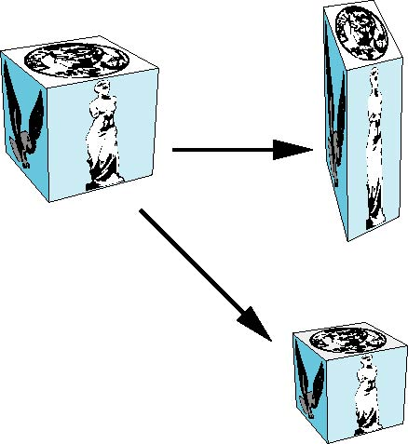
Scaling
Expand or contract along each axis (fixed point of origin)
x’=s_{x}x
y’=s_{y}y
z’=s_{z}z
p’=Sp
S = S(s_{x}, s_{y}, s_{z}) =

Slide 82
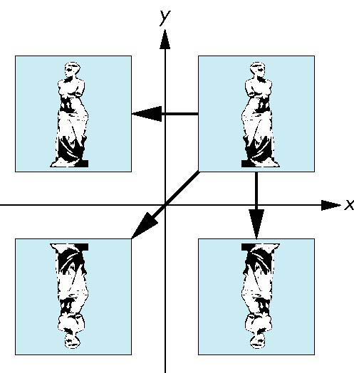
Reflection
corresponds to negative scale factors
s_{x} = -1 s_{y} = 1
original
s_{x} = -1 s_{y} = -1
s_{x} = 1 s_{y} = -1

Slide 83
Inverses
Although we could compute inverse matrices by general formulas, we can use simple geometric observations
Translation: T⁻¹(d_{x}, d_{y}, d_{z}) = T(-d_{x}, -d_{y}, -d_{z})
Rotation: R ⁻¹(θ) = R(-θ)
Holds for any rotation matrix
Note that since cos(-θ) = cos(θ) and sin(-θ)=-sin(θ)
R ⁻¹(θ) = R ^{T}(θ)
Scaling: S⁻¹(s_{x}, s_{y}, s_{z}) = S(1/s_{x}, 1/s_{y}, 1/s_{z})

Slide 84
Concatenation
We can form arbitrary affine transformation matrices by multiplying together rotation, translation, and scaling matrices
Because the same transformation is applied to many vertices, the cost of forming a matrix M=ABCD is not significant compared to the cost of computing Mp for many vertices p
The difficult part is how to form a desired transformation from the specifications in the application

Slide 85
Order of Transformations
Note that matrix on the right is the first applied
Mathematically, the following are equivalent
p’ = ABCp = A(B(Cp))
Note many references use column matrices to represent points. In terms of column matrices
p^{’T} = p^{T}C^{T}B^{T}A^{T}

Slide 86
General Rotation About the Origin
A rotation by θ about an arbitrary axis
can be decomposed into the concatenation
of rotations about the x, y, and z axes
R(θ) = R_{z}(θ_{z}) R_{y}(θ_{y}) R_{x}(θ_{x})
y
v
θ_{x} θ_{y} θ_{z} are called the Euler angles
θ
Note that rotations do not commute
We can use rotations in another order but
with different angles
x
z

Slide 87
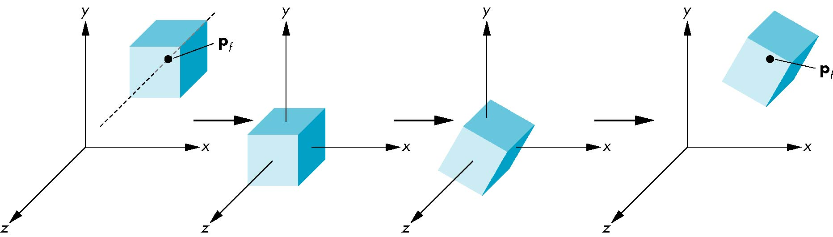
Rotation About a Fixed Point other than the Origin
Move fixed point to origin
Rotate
Move fixed point back
M = T(p_{f}) R(θ) T(-p_{f})

Slide 88
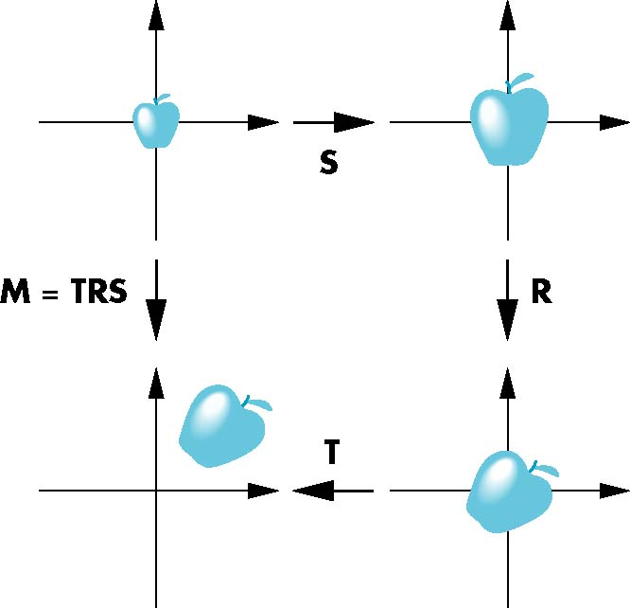
Instancing
In modeling, we often start with a simple object centered at the origin, oriented with the axis, and at a standard size
We apply an instance transformation to its vertices to
Scale
Orient
Locate

Slide 89
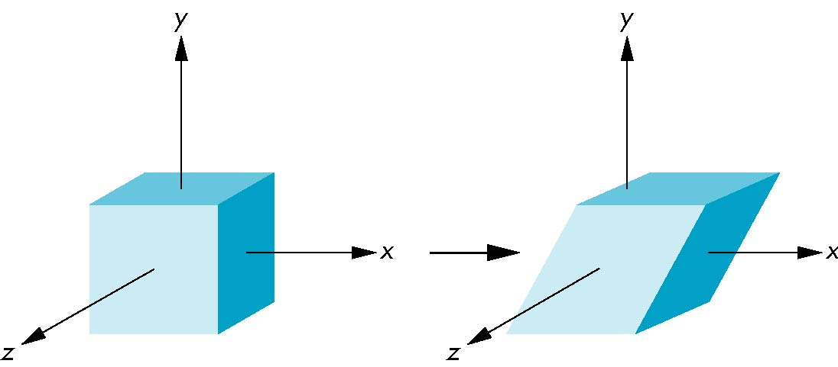
Shear
Helpful to add one more basic transformation
Equivalent to pulling faces in opposite directions

Slide 90
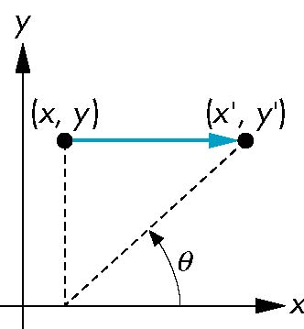
Shear Matrix
Consider simple shear along x axis
x’ = x + y cot θ
y’ = y
z’ = z
H(θ) =

Slide 91
WebGL Transformations

Slide 92
Objectives
Learn how to carry out transformations in WebGL
Rotation
Translation
Scaling
Introduce MV.js transformations
Model-view
Projection

Slide 93
Pre 3.1 OpenGL Matrices
In Pre 3.1 OpenGL matrices were part of the state
Multiple types
Model-View (GL_MODELVIEW)
Projection (GL_PROJECTION)
Texture (GL_TEXTURE)
Color(GL_COLOR)
Single set of functions for manipulation
Select which to manipulated by
glMatrixMode(GL_MODELVIEW);
glMatrixMode(GL_PROJECTION);

Slide 94
Why Deprecation
Functions were based on carrying out the operations on the CPU as part of the fixed function pipeline
Current model-view and projection matrices were automatically applied to all vertices using CPU
We will use the notion of a current transformation matrix with the understanding that it may be applied in the shaders

Slide 95
Current Transformation Matrix (CTM)
Conceptually there is a 4 x 4 homogeneous coordinate matrix, the current transformation matrix (CTM) that is part of the state and is applied to all vertices that pass down the pipeline
The CTM is defined in the user program and loaded into a transformation unit
C
p
p’=Cp
vertices
CTM
vertices

Slide 96
CTM operations
The CTM can be altered either by loading a new CTM or by postmutiplication
Load an identity matrix: C ← I
Load an arbitrary matrix: C ← M
Load a translation matrix: C ← T
Load a rotation matrix: C ← R
Load a scaling matrix: C ← S
Postmultiply by an arbitrary matrix: C ← CM
Postmultiply by a translation matrix: C ← CT
Postmultiply by a rotation matrix: C ← C R
Postmultiply by a scaling matrix: C ← C S

Slide 97
Rotation about a Fixed Point
Start with identity matrix: C ← I
Move fixed point to origin: C ← CT
Rotate: C ← CR
Move fixed point back: C ← CT ⁻¹
Result: C = TR T ^{–1} which is backwards.
This result is a consequence of doing postmultiplications.
Let’s try again.

Slide 98
Reversing the Order
We want C = T ^{–1} R T
so we must do the operations in the following order
C ← I
C ← CT ⁻¹
C ← CR
C ← CT
Each operation corresponds to one function call in the program.
Note that the last operation specified is the first executed in the program

Slide 99
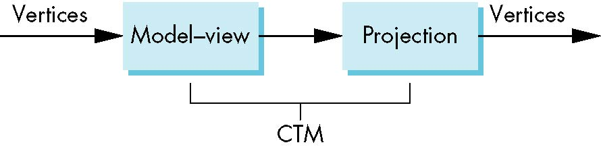
CTM in WebGL
OpenGL had a model-view and a projection matrix in the pipeline which were concatenated together to form the CTM
We will emulate this process

Slide 100
Using the ModelView Matrix
In WebGL, the model-view matrix is used to
Position the camera
Can be done by rotations and translations but is often easier to use the lookAt function in MV.js
Build models of objects
The projection matrix is used to define the view volume and to select a camera lens
Although these matrices are no longer part of the OpenGL state, it is usually a good strategy to create them in our own applications
q = P*MV*p

Slide 101
Rotation, Translation, Scaling
Create an identity matrix:
var m = mat4();
Multiply on right by rotation matrix of theta in degrees
where (vx, vy, vz) define axis of rotation
var r = rotate(theta, vx, vy, vz)
m = mult(m, r);
Also have rotateX, rotateY, rotateZ
Do same with translation and scaling:
var s = scale( sx, sy, sz)
var t = translate(dx, dy, dz);
m = mult(s, t);

Slide 102
Example
Rotation about z axis by 30 degrees with a fixed point of (1.0, 2.0, 3.0)
Remember that last matrix specified in the program is the first applied
var m = mult(translate(1.0, 2.0, 3.0),
rotate(30.0, 0.0, 0.0, 1.0));
m = mult(m, translate(-1.0, -2.0, -3.0));

Slide 103
Arbitrary Matrices
Can load and multiply by matrices defined in the application program
Matrices are stored as one dimensional array of 16 elements by MV.js but can be treated as 4 x 4 matrices in row major order
OpenGL wants column major data
gl.uniformMatrix4f has a parameter for automatic transpose by it must be set to false.
flatten function converts to column major order which is required by WebGL functions

Slide 104
Matrix Stacks
In many situations we want to save transformation matrices for use later
Traversing hierarchical data structures (Chapter 9)
Pre 3.1 OpenGL maintained stacks for each type of matrix
Easy to create the same functionality in JS
push and pop are part of Array object
var stack = [ ]
stack.push(modelViewMatrix);
modelViewMatrix = stack.pop();

Slide 105
Applying Transformations

Slide 106
Using Transformations
Example: Begin with a cube rotating
Use mouse or button listener to change direction of rotation
Start with a program that draws a cube in a standard way
Centered at origin
Sides aligned with axes
Will discuss modeling in next lecture

Slide 107
Where do we apply transformation?
Same issue as with rotating square
in application to vertices
in vertex shader: send MV matrix
in vertex shader: send angles
Choice between second and third unclear
Do we do trigonometry once in CPU or for every vertex in shader
GPUs have trig functions hardwired in silicon

Slide 108
Rotation Event Listeners
document.getElementById( "xButton" ).onclick = function () { axis = xAxis; }; document.getElementById( "yButton" ).onclick = function () { axis = yAxis; }; document.getElementById( "zButton" ).onclick = function () { axis = zAxis; };
function render(){
gl.clear( gl.COLOR_BUFFER_BIT | gl.DEPTH_BUFFER_BIT);
theta[axis] += 2.0;
gl.uniform3fv(thetaLoc, theta);
gl.drawArrays( gl.TRIANGLES, 0, NumVertices );
requestAnimFrame( render );
}

Slide 109
Rotation Shader
attribute vec4 vPosition;
attribute vec4 vColor;
varying vec4 fColor;
uniform vec3 theta;
void main() {
vec3 angles = radians( theta );
vec3 c = cos( angles );
vec3 s = sin( angles );
// Remember: these matrices are column-major
mat4 rx = mat4( 1.0, 0.0, 0.0, 0.0,
0.0, c.x, s.x, 0.0,
0.0, -s.x, c.x, 0.0,
0.0, 0.0, 0.0, 1.0 );

Slide 110
Rotation Shader (cont)
mat4 ry = mat4( c.y, 0.0, -s.y, 0.0,
0.0, 1.0, 0.0, 0.0,
s.y, 0.0, c.y, 0.0,
0.0, 0.0, 0.0, 1.0 );
mat4 rz = mat4( c.z, -s.z, 0.0, 0.0,
s.z, c.z, 0.0, 0.0,
0.0, 0.0, 1.0, 0.0,
0.0, 0.0, 0.0, 1.0 );
fColor = vColor;
gl_Position = rz * ry * rx * vPosition;
}

Slide 111
Smooth Rotation
From a practical standpoint, we are often want to use transformations to move and reorient an object smoothly
Problem: find a sequence of model-view matrices M₀,M₁,…..,M_{n} so that when they are applied successively to one or more objects we see a smooth transition
For orientating an object, we can use the fact that every rotation corresponds to part of a great circle on a sphere
Find the axis of rotation and angle
Virtual trackball (see text)

Slide 112
Incremental Rotation
Consider the two approaches
For a sequence of rotation matrices R₀,R₁,…..,R_{n} , find the Euler angles for each and use R_{i}= R_{iz} R_{iy} R_{ix}
Not very efficient
Use the final positions to determine the axis and angle of rotation, then increment only the angle
Quaternions can be more efficient than either

Slide 113
Quaternions
Extension of imaginary numbers from two to three dimensions
Requires one real and three imaginary components i, j, k
Quaternions can express rotations on sphere smoothly and efficiently. Process:
Model-view matrix → quaternion
Carry out operations with quaternions
Quaternion → Model-view matrix
q=q₀+q₁i+q₂j+q₃k

Slide 114
Building Models

Slide 115
Objectives
Introduce simple data structures for building polygonal models
Vertex lists
Edge lists

Slide 116
Representing a Mesh
e₂
Consider a mesh
There are 8 nodes and 12 edges
5 interior polygons
6 interior (shared) edges
Each vertex has a location v_{i} = (x_{i} y_{i} z_{i})
v₅
v₆
e₃
e₉
e₈
v₈
v₄
e₁
e₁₁
e₁₀
e₇
v₇
e₄
v₁
v₂
e₁₂
e₆
v₃
e₅

Slide 117
Simple Representation
Define each polygon by the geometric locations of its vertices
Leads to WebGL code such as
Inefficient and unstructured
Consider moving a vertex to a new location
Must search for all occurrences
vertex.push(vec3(x1, y1, z1));
vertex.push(vec3(x6, y6, z6));
vertex.push(vec3(x7, y7, z7));

Slide 118
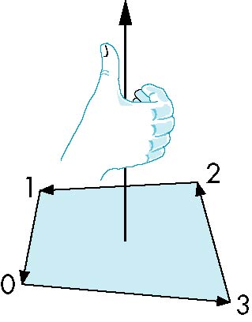
Inward and Outward Facing Polygons
The order {v₁, v₆, v₇} and {v₆, v₇, v₁} are equivalent in that the same polygon will be rendered by OpenGL but the order {v₁, v₇, v₆} is different
The first two describe outwardly
facing polygons
Use the right-hand rule =
counter-clockwise encirclement
of outward-pointing normal
OpenGL can treat inward and
outward facing polygons differently

Slide 119
Geometry vs Topology
Generally it is a good idea to look for data structures that separate the geometry from the topology
Geometry: locations of the vertices
Topology: organization of the vertices and edges
Example: a polygon is an ordered list of vertices with an edge connecting successive pairs of vertices and the last to the first
Topology holds even if geometry changes

Slide 120
Vertex Lists
Put the geometry in an array
Use pointers from the vertices into this array
Introduce a polygon list
x₁ y₁ z₁
x₂ y₂ z₂
x₃ y₃ z₃
x₄ y₄ z₄
x₅ y₅ z_{5.}
x₆ y₆ z₆
x₇ y₇ z₇
x₈ y₈ z₈
v₁
v₇
v₆
P1
P2
P3
P4
P5
v₈
v₅
v₆
topology
geometry

Slide 121
Shared Edges
Vertex lists will draw filled polygons correctly but if we draw the polygon by its edges, shared edges are drawn twice
Can store mesh by edge list

Slide 122
Edge List
e₂
v₅
x₁ y₁ z₁
x₂ y₂ z₂
x₃ y₃ z₃
x₄ y₄ z₄
x₅ y₅ z_{5.}
x₆ y₆ z₆
x₇ y₇ z₇
x₈ y₈ z₈
v₆
e₃
e1
e2
e3
e4
e5
e6
e7
e8
e9
v1
v6
e₉
e₈
v₈
e₁
e₁₁
e₁₀
e₇
v₇
e₄
v₁
v₂
e₁₂
e₆
v₃
e₅
Note polygons are
not represented

Slide 123
Draw cube from faces
var colorCube( )
{
quad(0,3,2,1);
quad(2,3,7,6);
quad(0,4,7,3);
quad(1,2,6,5);
quad(4,5,6,7);
quad(0,1,5,4);
}
5
6
2
1
7
4
0
3

Slide 124
The Rotating Square

Slide 125
Objectives
Put everything together to display rotating cube
Two methods of display
by arrays
by elements

Slide 126
Modeling a Cube
Define global array for vertices
var vertices = [
vec3( -0.5, -0.5, 0.5 ),
vec3( -0.5, 0.5, 0.5 ),
vec3( 0.5, 0.5, 0.5 ),
vec3( 0.5, -0.5, 0.5 ),
vec3( -0.5, -0.5, -0.5 ),
vec3( -0.5, 0.5, -0.5 ),
vec3( 0.5, 0.5, -0.5 ),
vec3( 0.5, -0.5, -0.5 )
];

Slide 127
Colors
Define global array for colors
var vertexColors = [
[ 0.0, 0.0, 0.0, 1.0 ], // black
[ 1.0, 0.0, 0.0, 1.0 ], // red
[ 1.0, 1.0, 0.0, 1.0 ], // yellow
[ 0.0, 1.0, 0.0, 1.0 ], // green
[ 0.0, 0.0, 1.0, 1.0 ], // blue
[ 1.0, 0.0, 1.0, 1.0 ], // magenta
[ 0.0, 1.0, 1.0, 1.0 ], // cyan
[ 1.0, 1.0, 1.0, 1.0 ] // white
];

Slide 128
Draw cube from faces
function colorCube( )
{
quad(0,3,2,1);
quad(2,3,7,6);
quad(0,4,7,3);
quad(1,2,6,5);
quad(4,5,6,7);
quad(0,1,5,4);
}
5
6
2
1
7
4
0
3
Note that vertices are ordered so that
we obtain correct outward facing normals
Each quad generates two triangles

Slide 129
Initialization
var canvas, gl;
var numVertices = 36;
var points = [];
var colors = [];
window.onload = function init(){
canvas = document.getElementById( "gl-canvas" );
gl = WebGLUtils.setupWebGL( canvas );
colorCube();
gl.viewport( 0, 0, canvas.width, canvas.height );
gl.clearColor( 1.0, 1.0, 1.0, 1.0 );
gl.enable(gl.DEPTH_TEST);
// rest of initialization and html file
// same as previous examples

Slide 130
The quad Function
Put position and color data for two triangles from a list of indices into the array vertices
var quad(a, b, c, d)
{
var indices = [ a, b, c, a, c, d ];
for ( var i = 0; i < indices.length; ++i ) {
points.push( vertices[indices[i]]);
colors.push( vertexColors[indices[i]] );
// for solid colored faces use
//colors.push(vertexColors[a]);
}
}

Slide 131
Render Function
function render(){
gl.clear( gl.COLOR_BUFFER_BIT |gl.DEPTH_BUFFER_BIT);
gl.drawArrays( gl.TRIANGLES, 0, numVertices );
requestAnimFrame( render );
}

Slide 132
Mapping indices to faces
var indices = [
1,0,3,
3,2,1,
2,3,7,
7,6,2,
3,0,4,
4,7,3,
6,5,1,
1,2,6,
4,5,6,
6,7,4,
5,4,0,
0,1,5
];

Slide 133
Rendering by Elements
Send indices to GPU
Render by elements
Even more efficient if we use triangle strips or triangle fans
var iBuffer = gl.createBuffer();
gl.bindBuffer(gl.ELEMENT_ARRAY_BUFFER, iBuffer);
gl.bufferData(gl.ELEMENT_ARRAY_BUFFER,
new Uint8Array(indices), gl.STATIC_DRAW);
gl.drawElements( gl.TRIANGLES, numVertices,
gl.UNSIGNED_BYTE, 0 );

Slide 134
Adding Buttons for Rotation
var xAxis = 0;
var yAxis = 1;
var zAxis = 2;
var axis = 0;
var theta = [ 0, 0, 0 ];
var thetaLoc;
document.getElementById( "xButton" ).onclick = function () { axis = xAxis; }; document.getElementById( "yButton" ).onclick = function () { axis = yAxis; }; document.getElementById( "zButton" ).onclick = function () { axis = zAxis; };

Slide 135
Render Function
function render(){
gl.clear( gl.COLOR_BUFFER_BIT |gl.DEPTH_BUFFER_BIT);
theta[axis] += 2.0;
gl.uniform3fv(thetaLoc, theta);
gl.drawArrays( gl.TRIANGLES, 0, numVertices );
requestAnimFrame( render );
}

